Slide 1

Bootleg Macro Pleb

Slide 2
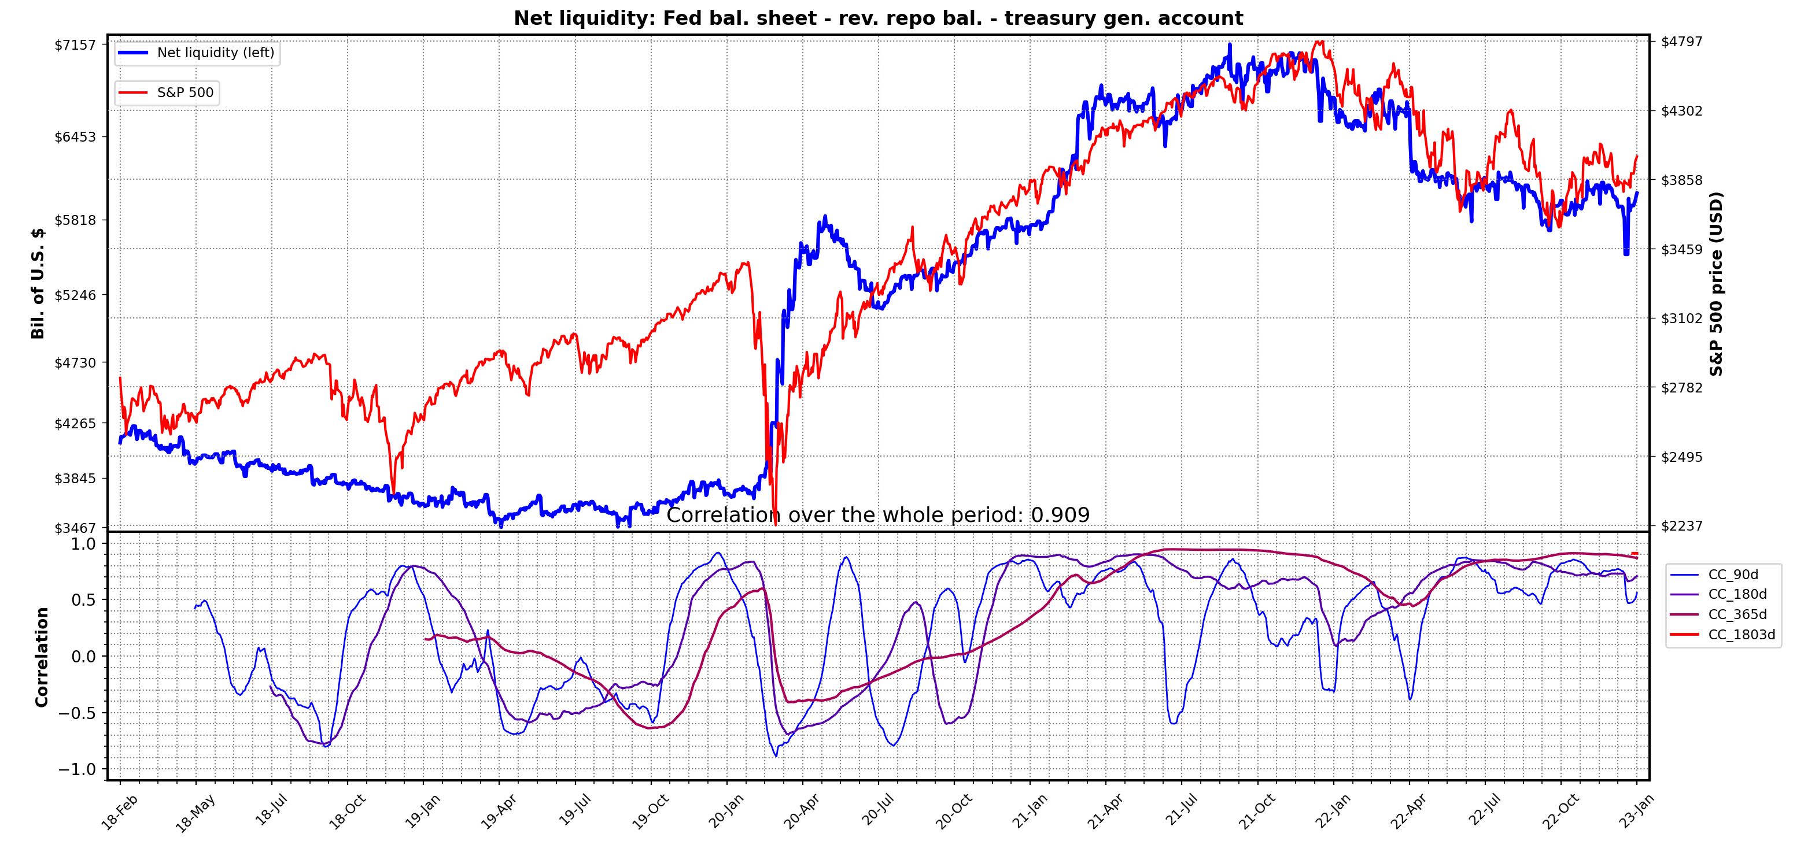
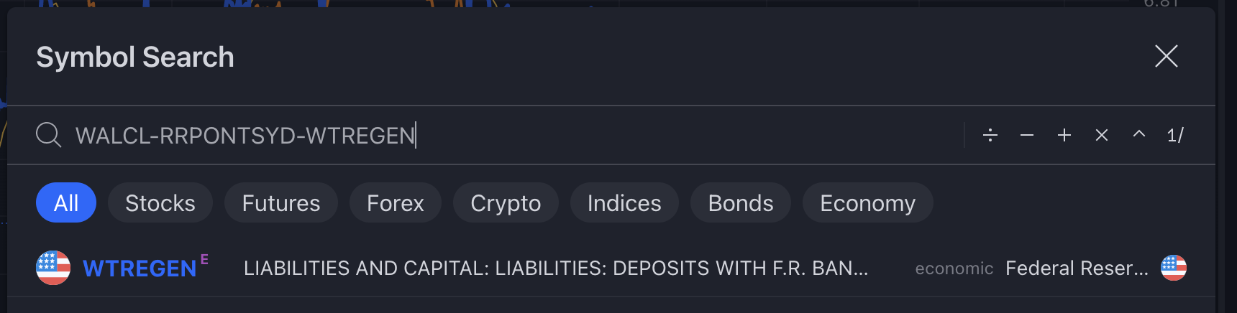
NET LIQUIDITY
1/ USD NET LIQUIDITY (NLQ): this has become an important macro metric to track. Originally formulated by @DariusDale and 42 Macro. This provides a daily estimate of the total liquidity being provided to markets by the Fed, treasury and big money funds.
FED fueled QE
bender start
High correlation since then
2/ Following March 2020, the huge surge in net liquidity provided by unprecedented QE made it this liquidity tide the primary driving force behind markets. High correlation now seen between SPX,NDQ,DJI,BTC etc & NLQ. Great intro here by @maxjanderson:
3/ You’ve probably heard of NLQ by now & would like to track it for yourself. Max’s thread provides great explanation of why NLQ is important & where to get data. You’ll need some kind of script though.
4/ I’ve written a python script to pull and display the daily NLQ series so you don’t have to. Script uses Fed bal. sheet (weekly) & RevRepo (daily) from FRED. It gets the TGA bal. direct from treasury site (daily series).
5/ You can also see NLQ on tradingview, search: WALCL-RRPONTSYD-WTREGEN
6/ TV gets the 3 series from FRED. Fed bal. sheet updated weekly, treasury general account (TGA) & RevRepo bal. are updated daily. From FRED, you can only get weekly average of TGA. Thus NLQ series on TV is mostly weekly data and doesn’t move as fast daily.

Slide 3
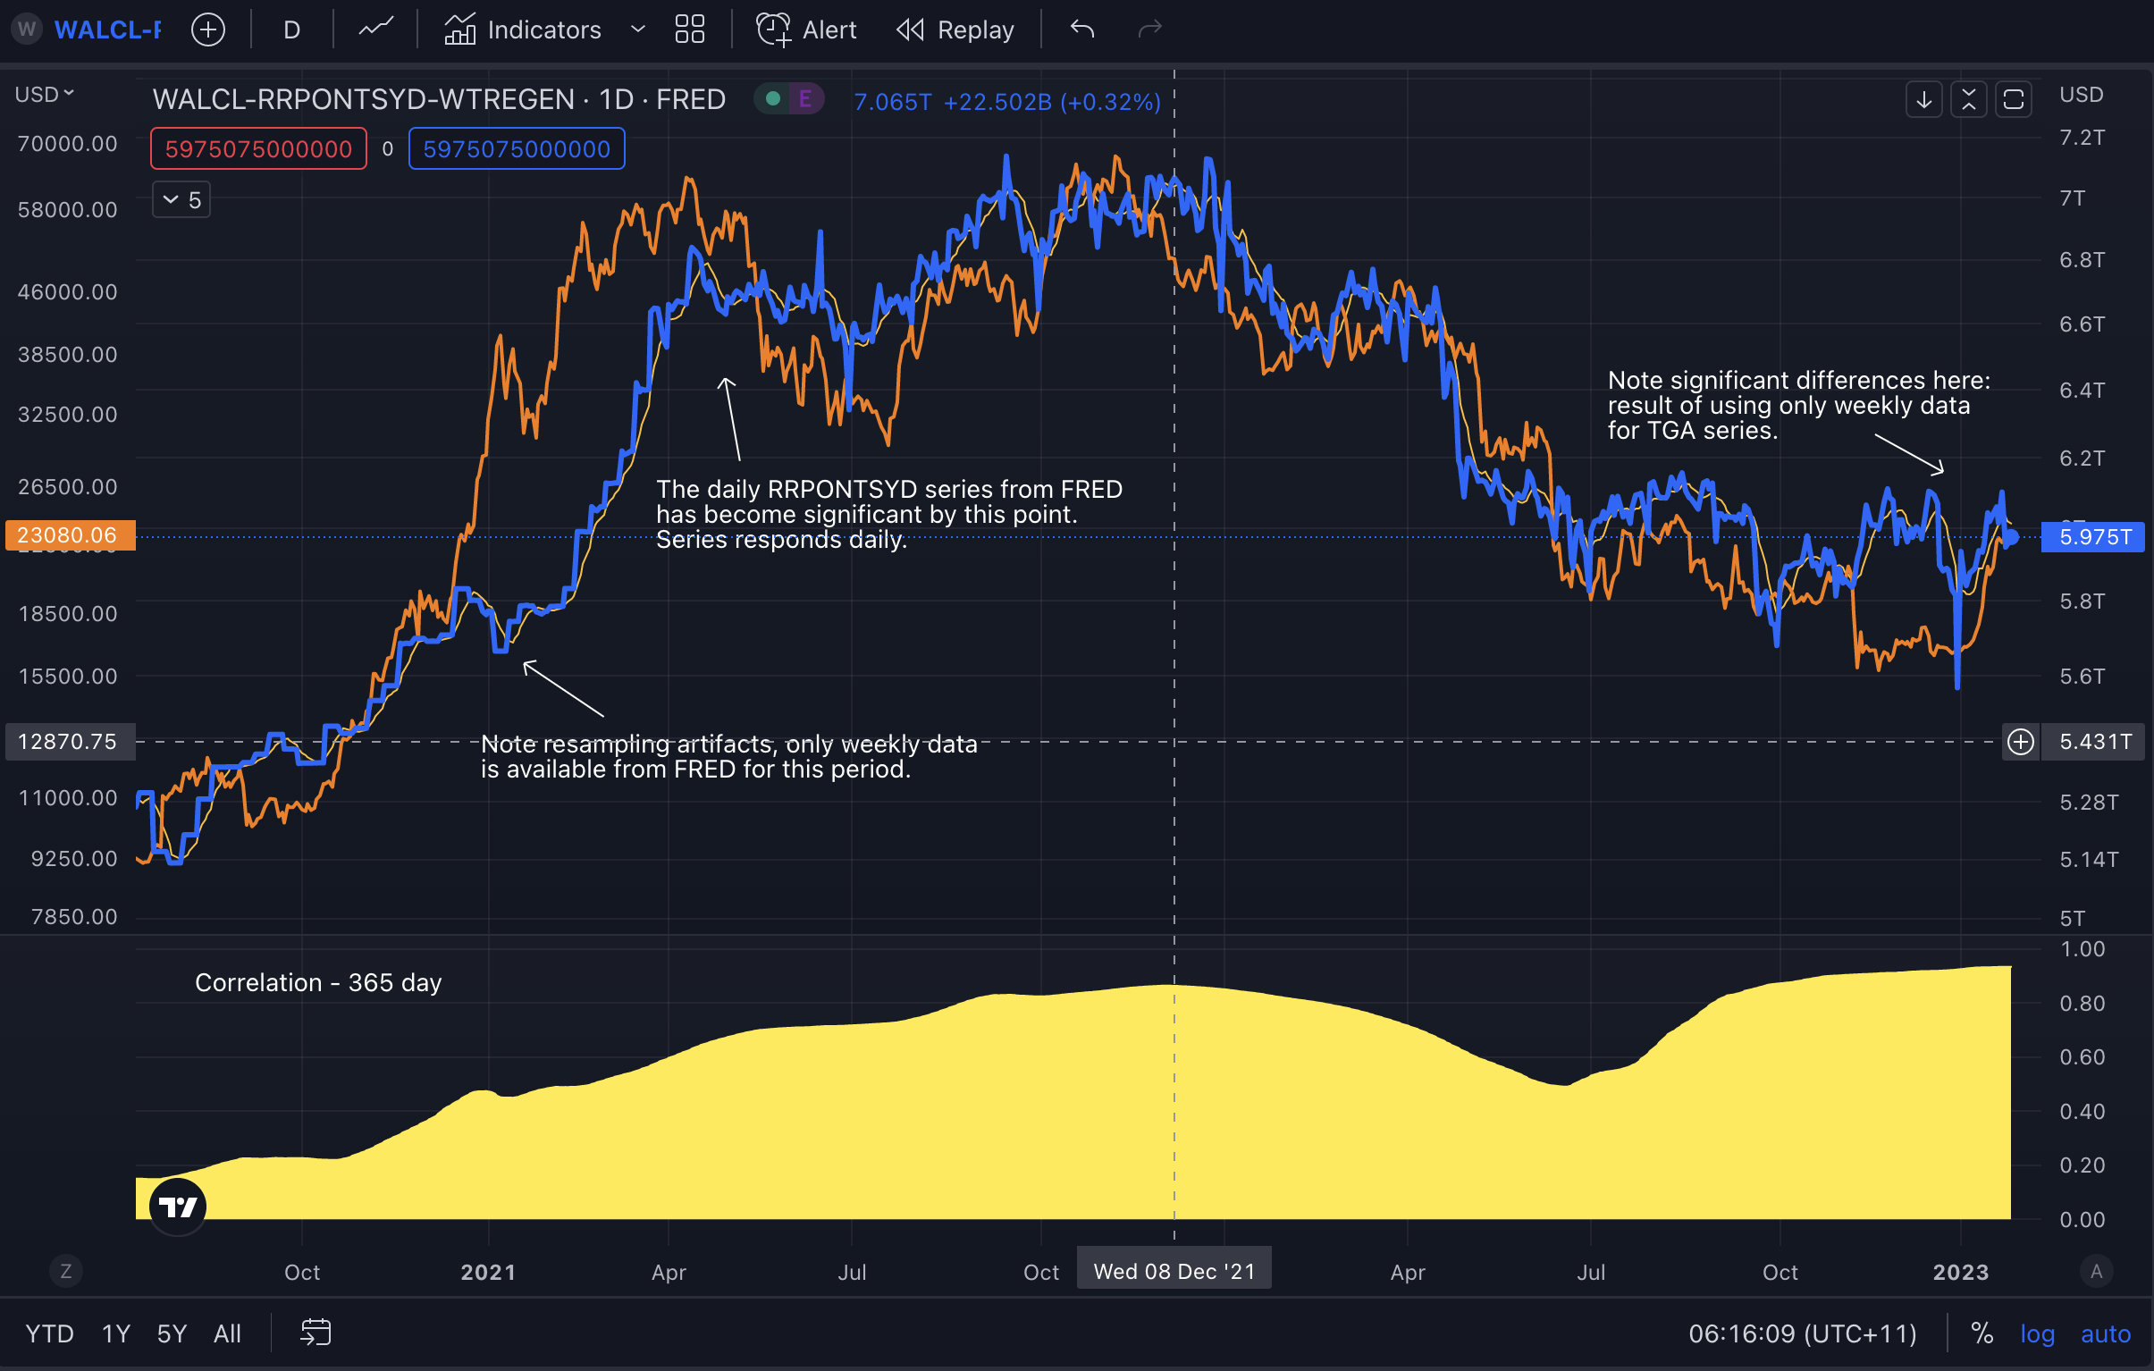
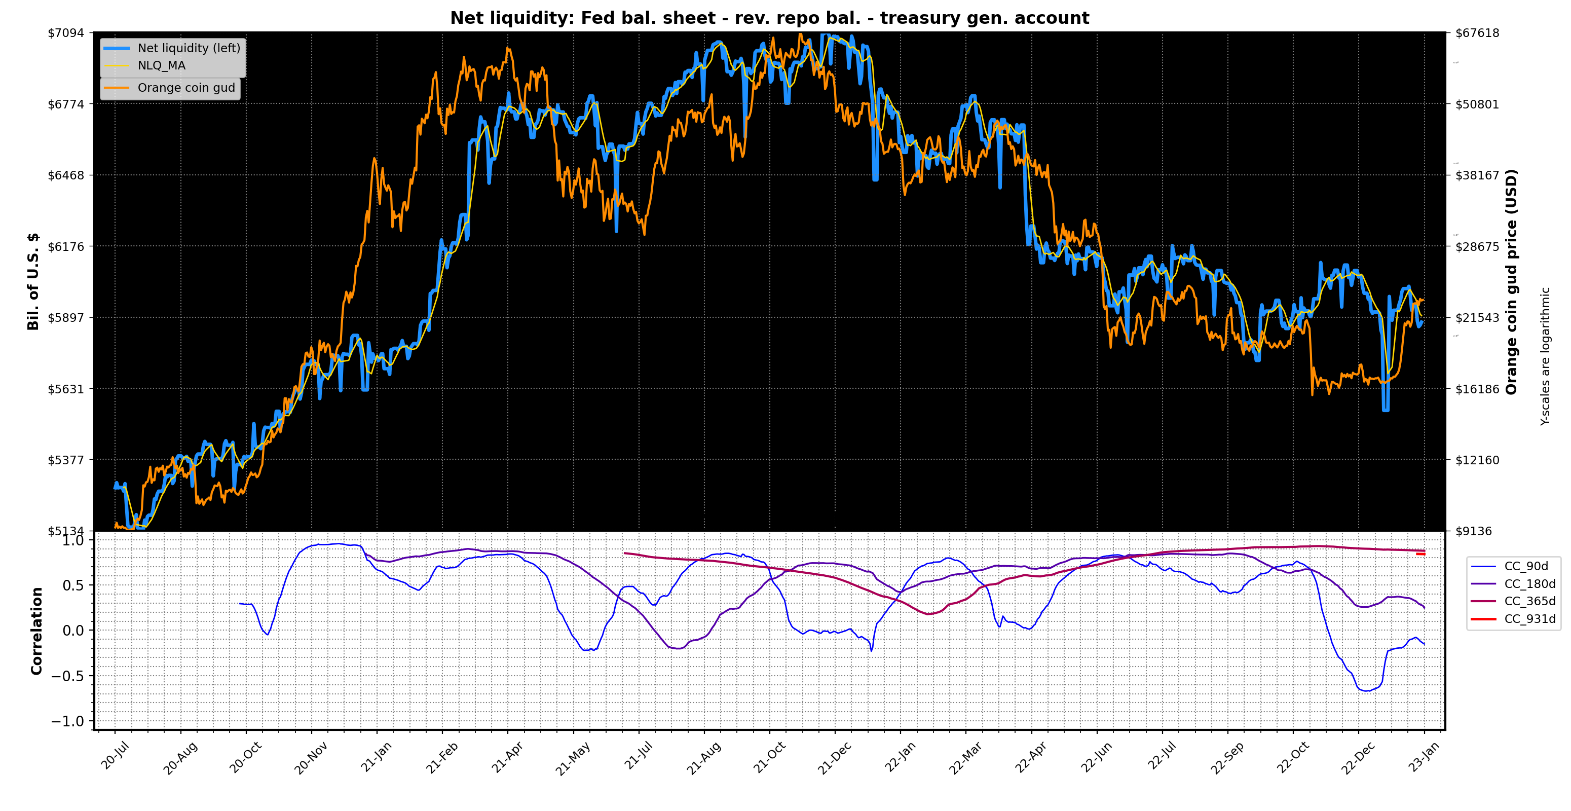
7/ Comparison to trading view series. Hard to beat a TV chart but I think mine comes close. There may be an advantage using my script as it uses the daily TGA data. Note differences in NLQ due to use of daily TGA data.

Slide 4
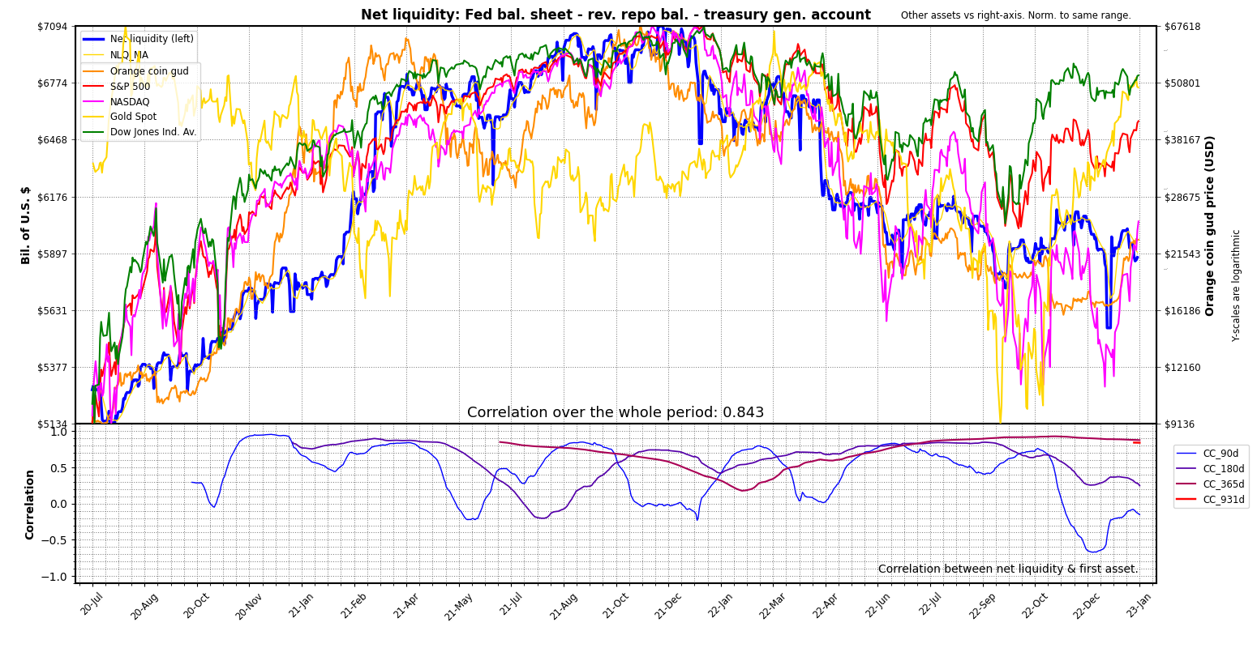
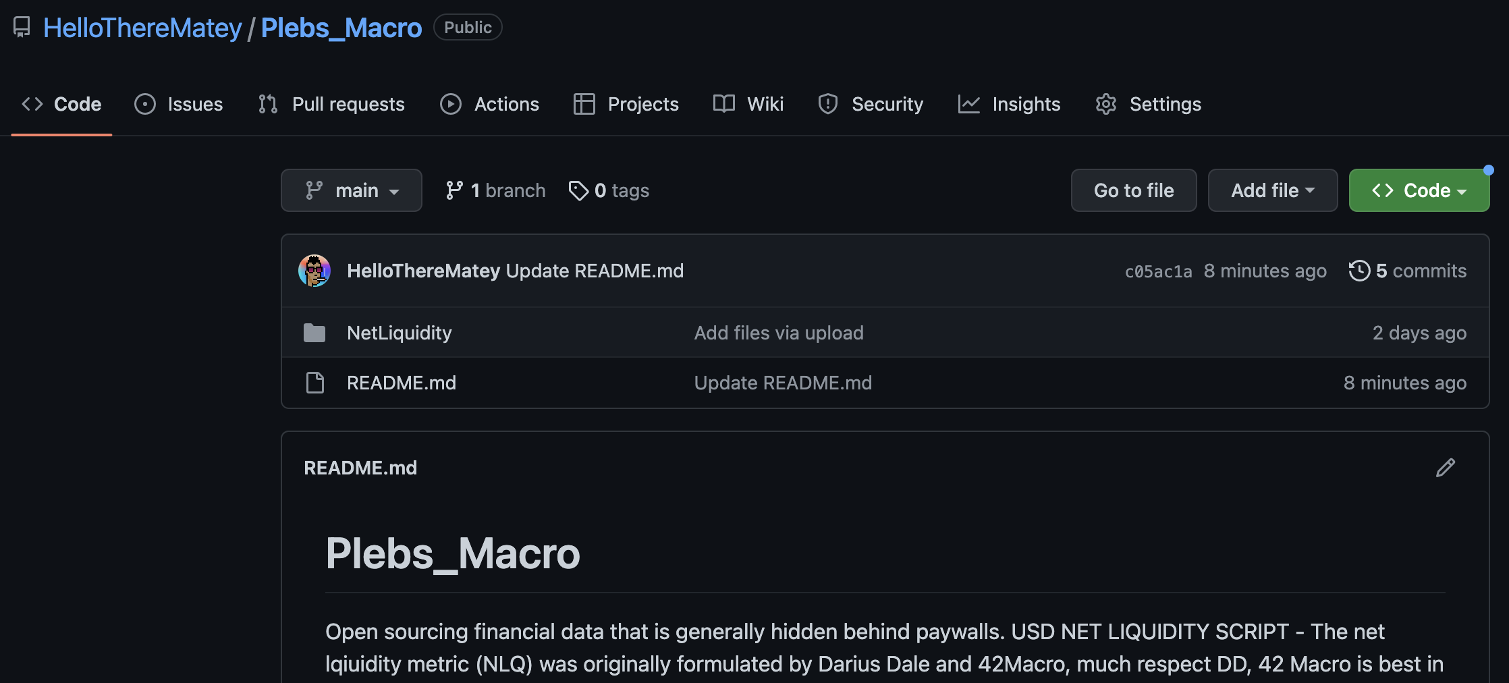
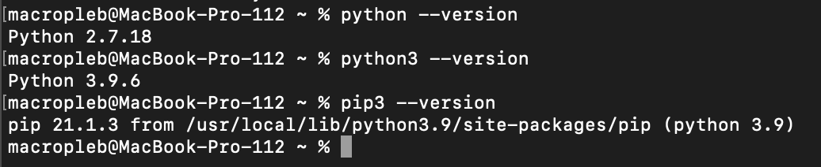
8/ You can choose up to 5 assets for comparison. Correlation is calculated for the first asset (BTC here below). Prices sourced from yahoo, google finance, trading view, coin gecko and others, covers the majority of tickers.
7/ Script is easy to use even if you’ve never coded. I’ll show how to use through terminal & excel on windows,mac,linux. Go to the github repo and download the repo (Code -> Download ZIP):
https://github.com/HelloThereMatey/Plebs_Macro
8/ Unzip & place NetLiquidity project folder where you wish. Open terminal, Enter: python –-version to check if python installed. Also check for pip. On mac use python3/pip3.

Slide 5
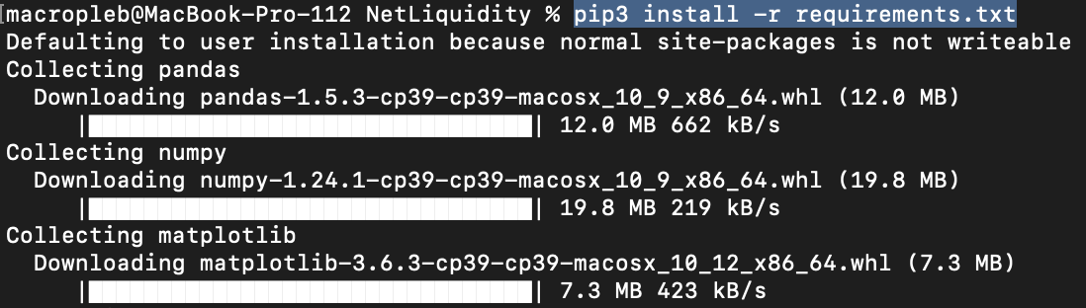
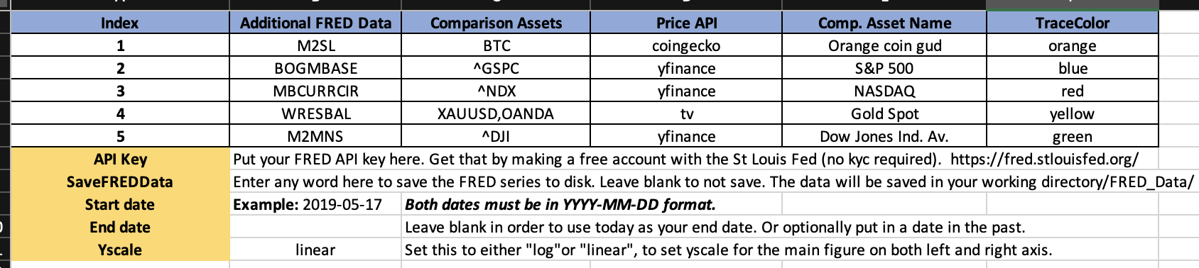
9/ If you’ve no python/pip installed you’ll see ‘command not found’. On windows, search ‘python’ on windows app store and install latest version free. Mac/linux see: docs.python-guide.org/starting/installation/
10/ Now you have python & pip, you’ll need the required modules used by script. Type ‘cd’ and drag & drop the ‘NetLiquidity’ folder onto the terminal + hit enter. That will set it as the working directory.
11/ Use pip to install the required python modules: pip install –r requirements.txt (pip3 on mac). These are collections of python scripts like mine yet are better written and are well-vetted by community.
12/ Now you’re ready to use the script. Open NetLiquidity_InputParams.xlsx. All parameters are set using this file. Simply enter ticker names, start date etc in the cells indicated in “Parameters’ sheet, save file. Helpful info found in other sheet.
13/ .csv or .ods etc. could be used as free alternatives to excel, let me know if you want support for that. You can choose up to 5 assets to plot atop NLQ & 5 extra series to pull from FRED.

Slide 6
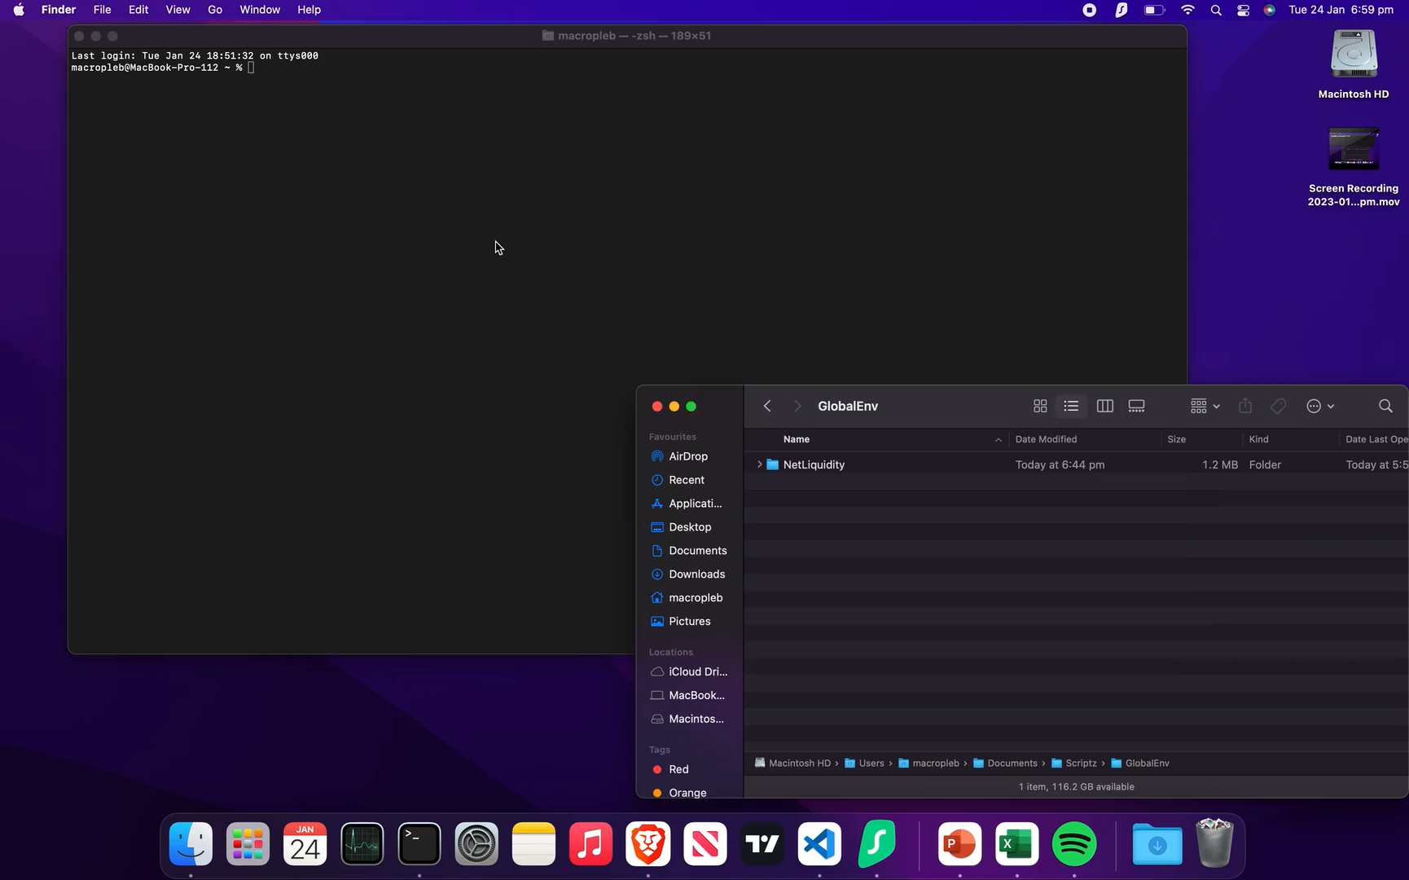
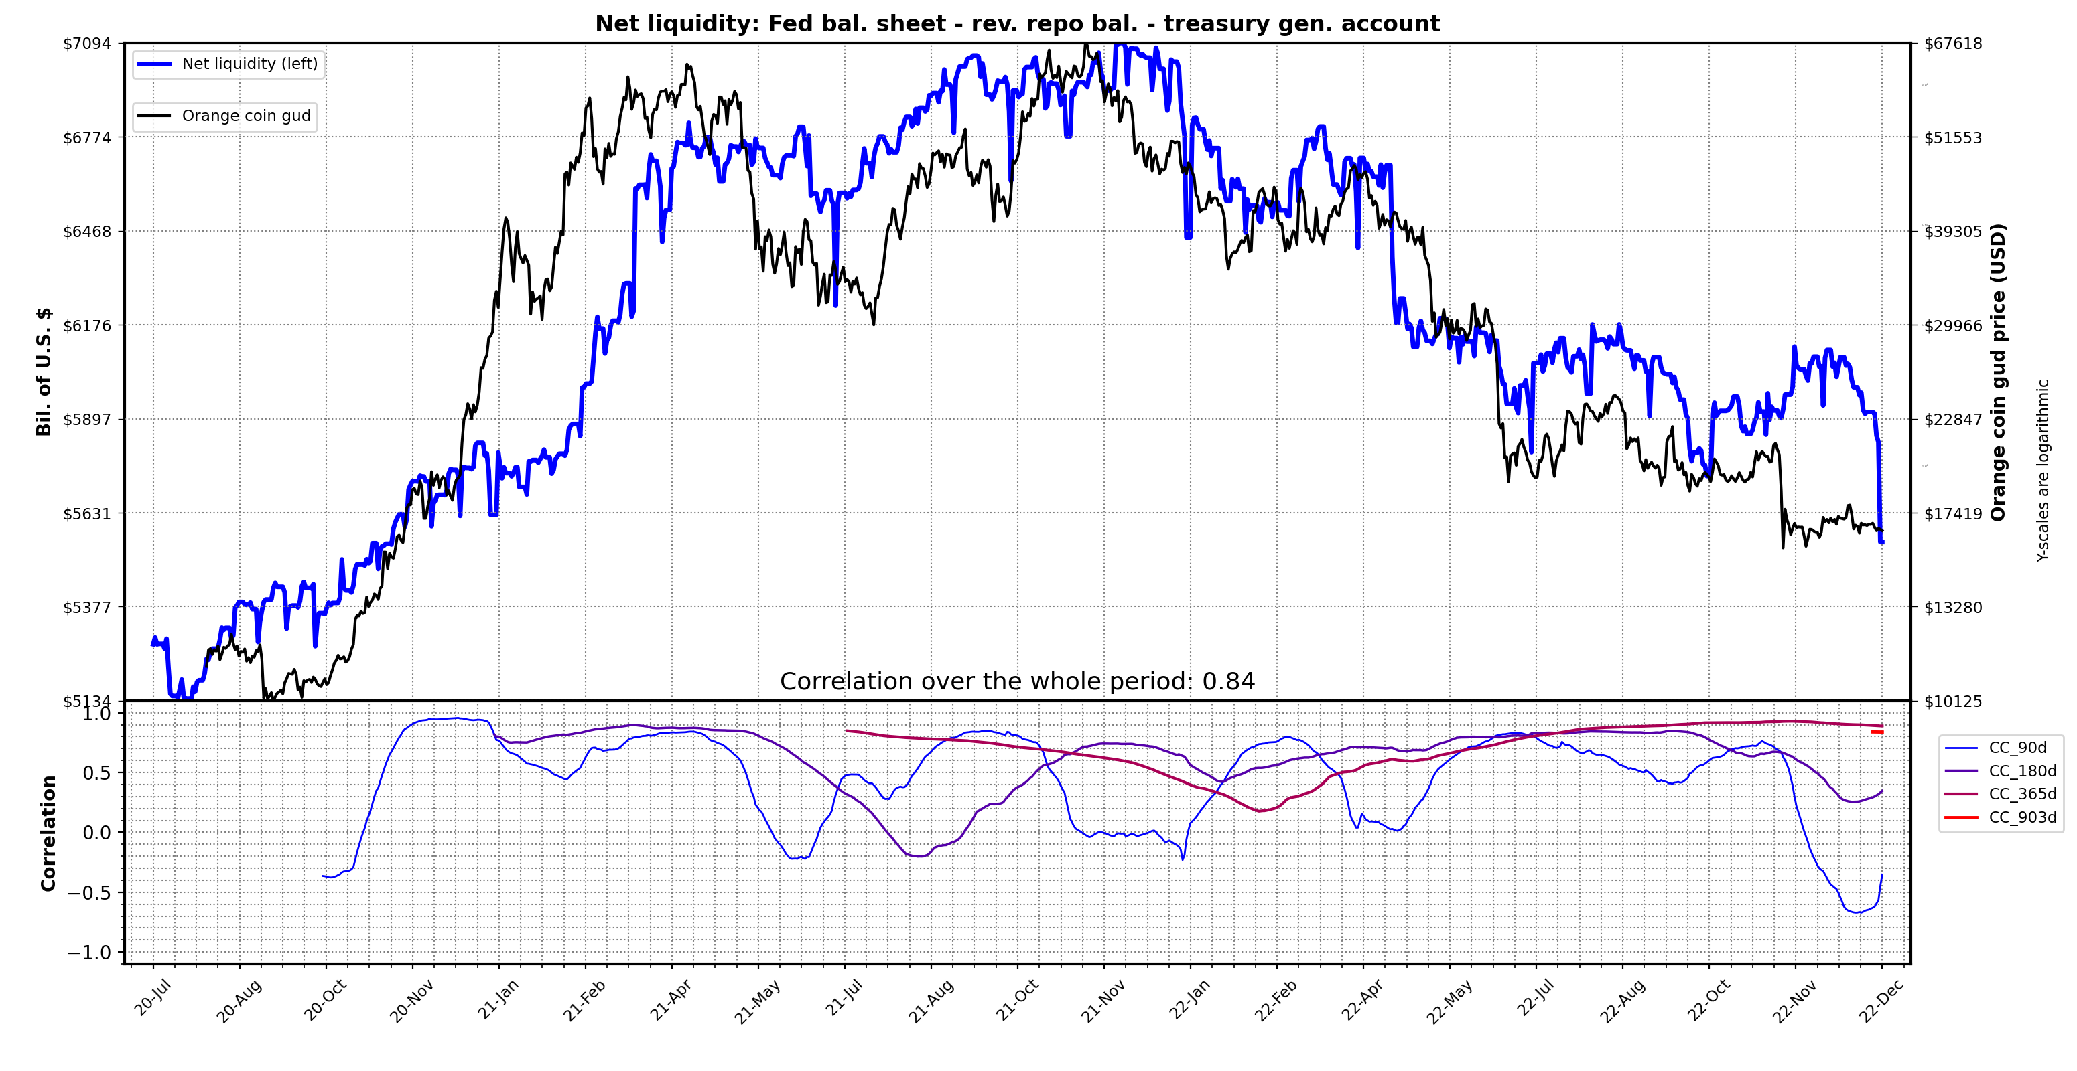
14/ Now run the script. Enter python ShowNetLiq.py, to run the script (python3-mac). Here’s a video of the process below. Internet access necessary.
15/ Let’s compare the data with other sources for verification. TV comparison on tweet 7. Below at top is @42Macro chart from Jan 3 and my chart at bottom. The NLQ series (blue) are almost identical.
42macro

Slide 7
15/ So now you can track net liquidity on a daily basis with no subscriptions required. Let me know how how it works for you & contact me with any error messages or bugs that you find. It still needs testing on OS other than mac.
16/ Here’s some good threads about net liquidity other than @maxjanderson thread which is the best.
https://twitter.com/Asymmetry_Fi/status/1615021057819148295?s=20&t=PskjvDT_L_3OHzK9eKt36Q
https://twitter.com/TimmerFidelity/status/1617934127616983040?s=20&t=PskjvDT_L_3OHzK9eKt36Q
17/ I think Darius Dale and @42MacroAlerts originally formulate this metric. Here’s the man himself discussing NLQ with Jack Farley (towards end of episode):
https://twitter.com/42MacroAlerts/status/1616151939787390977?s=20&t=PskjvDT_L_3OHzK9eKt36Q
18/ Please like & retweet first tweet from thread if you will. I plan to release a series of scripts like this for the average pleb to access macro metrics that are generally hidden behind a paywall. Follow me if interested. Contact me if keen to collaborate. Cheers.
19/ Tagging plebs & chads for reach………..

